Slide 1
Local Reference Fields
June 2011
Notes:
© 2006 Capgemini - All rights reserved
0

Slide 2
Topics for the session
LOCAL.TABLE
LOCAL.REF.TABLE

Slide 3
Objective
At the end of this session, participants will
Appreciate feature of local reference field in T24
Know to create a local reference field for T24 application
Know to how to set up conditions for a local reference field

Slide 4
Introduction to Local Reference Fields

Slide 5
Why Local Reference Fields?
Not all fields required by a bank are available in a T24 application
Local Reference Field are User defined & totally customizable
Once created, can be reused in various applications

Slide 6
How to Create Local Reference Field?
LOCAL.TABLE – To create field and assign properties
LOCAL.REF.TABLE – To attach created field to application

Slide 7
LOCAL.TABLE

Slide 8
Important Fields
ID is alphanumeric
Description – Holds a description of the field
Short Name – Name that is displayed for that field
Maximum Char – Maximum number of characters that the field can hold

Slide 9
Important Fields
Minimum Char – If entered, the field becomes a mandatory field in the application
Char Type – Type of data that can be input in this field
Vetting Table – List of predefined values the field can hold
Remark – Enrichment for items in the vetting table
Notes:
Vetting table – Each value specified in vetting table should be defined in a single table/application.

Slide 10
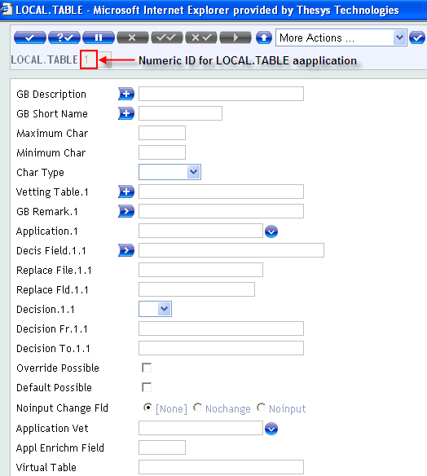
LOCAL.TABLE

Slide 11
Local Reference Creation
Enter LOCAL.TABLE, I followed by numeric value in command line
Input details in the mandatory as well as other required fields
Commit the record

Slide 12
Example
Create a local reference field ‘Customer Gender’

Slide 13
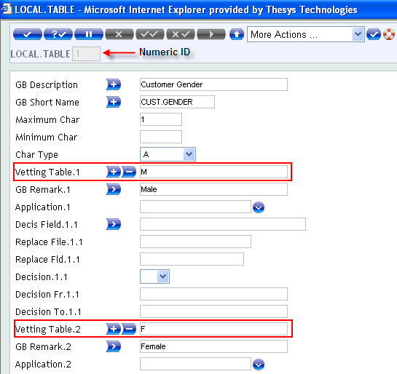
Solution
Create the field Customer Gender using LOCAL.TABLE application

Slide 14
LOCAL.REF.TABLE

Slide 15
Important Fields
ID – T24 application that the local reference field is going to be attached to
Local Table No. – ID of the LOCAL.TABLE
Sub Assoc Code – Must be used if the local reference field is a multi value or an associated multi value
XX. Multi Value
XX< Start of an associated multi value set
XX- Part of an associated multi value set
XX> End of the associated multi value set

Slide 16
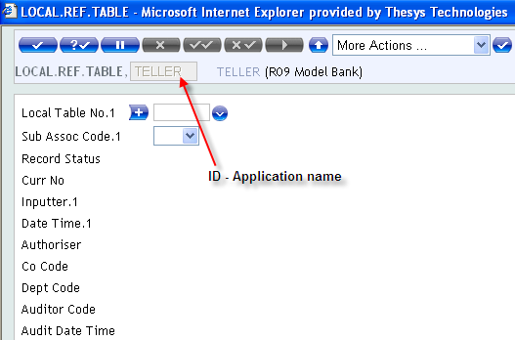
LOCAL.REF.TABLE

Slide 17
Local Reference Field Creation
Enter LOCAL.REF.TABLE I followed by application name in command line
Input ID of LOCAL.TABLE
Commit and authorize the record

Slide 18
Example
Create local reference field ‘Customer Gender’ to Customer application

Slide 19
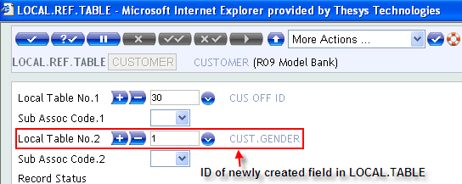
Solution
Attach the created local reference field to Customer application

Slide 20
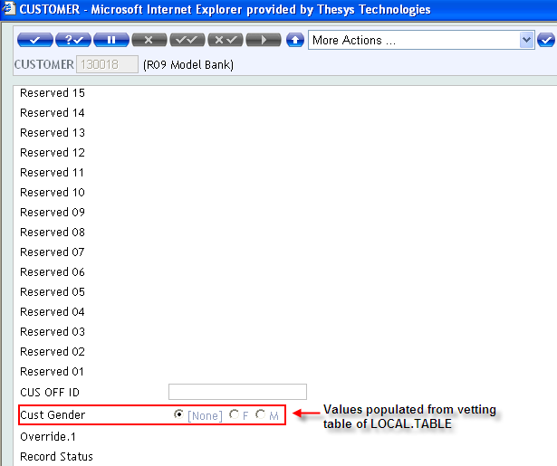
Solution
The local reference appears in application as shown

Slide 21
Workshop

Slide 22
Workshop 1
Create a local reference field ‘Secured Y N’ and attach it to Account application

Slide 23
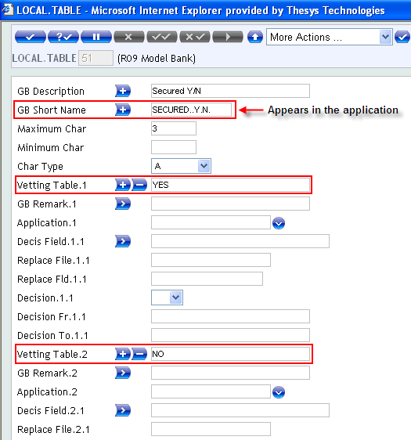
Solution 1
Create a local field using LOCAL.TABLE application

Slide 24
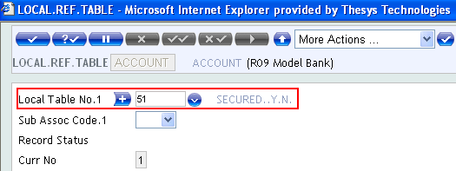
Solution 1
Create an entry of the newly created local field in the Account application

Slide 25
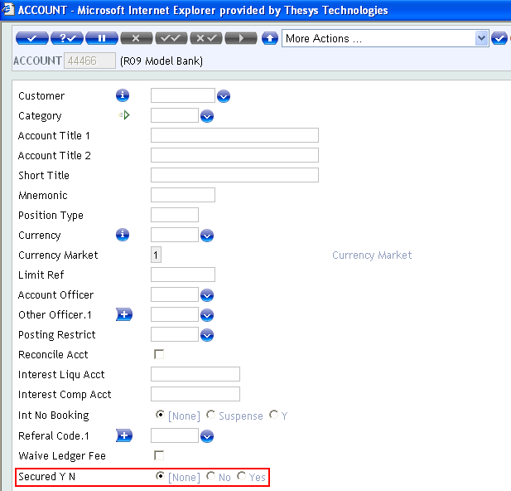
Solution 1
The attached Local Reference field appears in Account application as shown

Slide 26
Workshop 2
Create local reference fields ‘ID Proof’ and ‘Proof’ for Account application, setting Proof as multi-value field

Slide 27
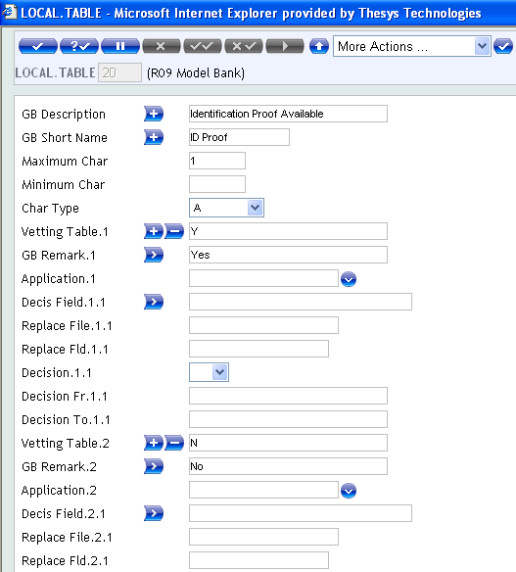
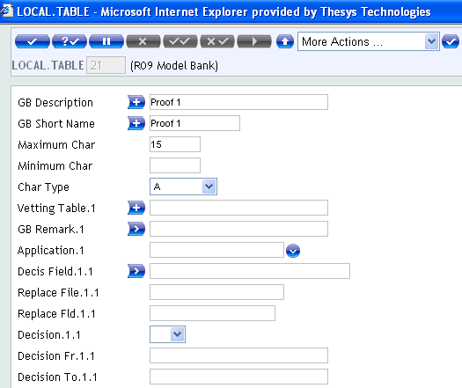
Solution 2
Create local fields using LOCAL.TABLE application as shown

Slide 28


Solution 2

Slide 29
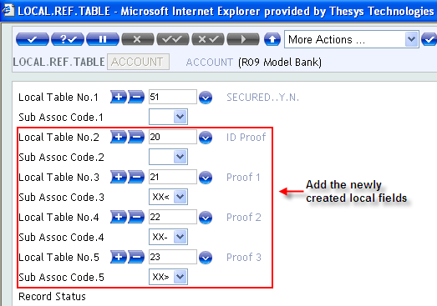
Solution 2
Create an entry of the newly created local field in the Account application

Slide 30
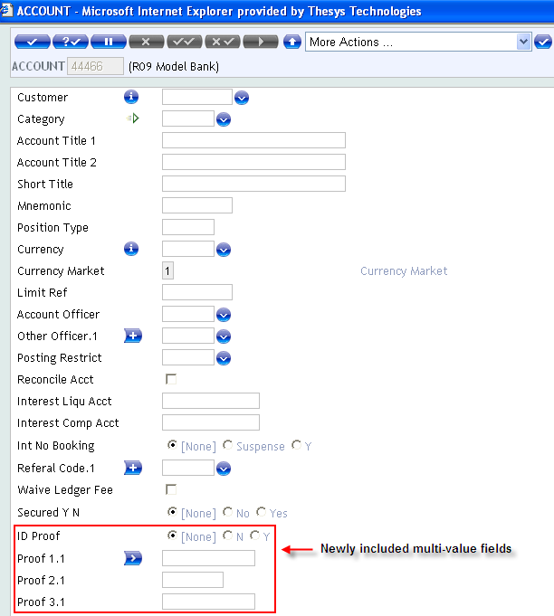
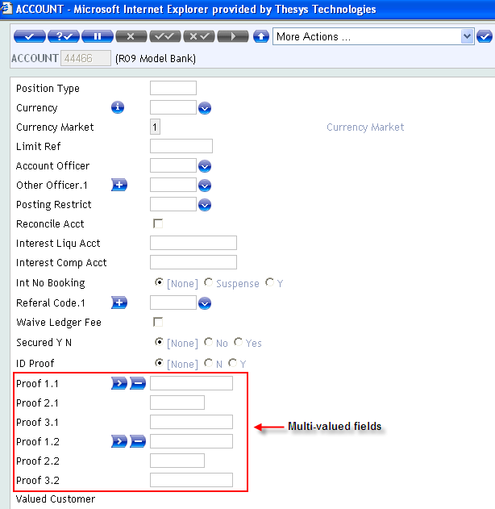
Solution 2
The Local Reference field appears as shown

Slide 31
Additional Features

Slide 32
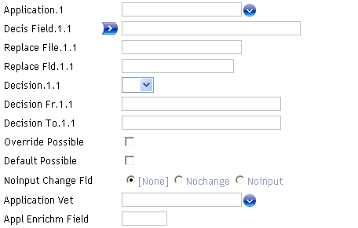
Local Reference Fields with condition
The Local reference field can be set as No Input field and then can be defaulted based on condition
For condition setup, use the LOCAL.TABLE fields (shown in screen shot)

Slide 33
Important Fields
Application – To which the local field is going to be attached
Decis Field – Field in the application whose value has to be checked
Replace File – Another application
Replace Fld – Field in application whose value needs to be checked

Slide 34
Important Fields
Decision - 'EQ', 'GE', 'GT', 'LE', 'LK', 'LT', 'NE', or 'UL'.
Decision Fr / Decision To – Range of values can be specified
Override Possible – Can input in the local field differ from the decision set
Default Possible – If Y, value in vetting table is defaulted
Noinput change Fld – Local field property can be set to no input or no change

Slide 35
Important Fields
Application Vet – Application against the key of which the field is being validated
Appl Enrichm Field – Which field in the application mentioned above is to be used as enrichment

Slide 36
Example
Create a conditional local reference field ‘Valued Customer’ for Account application
Wherein the field is updated with ‘Y’, when the conditions sector = 1000 and category = 1001 are satisfied
The field is updated with ‘N’, when the conditions sector = 1000 and category = 1001 are not satisfied

Slide 37
Solution
Create a local field ‘Valued Customer’
This local field is to be attached to Account application
Customer field in Account is the link to Customer file from where Sector value is picked up and checked as the first condition
The second condition is Category field in Account

Slide 38
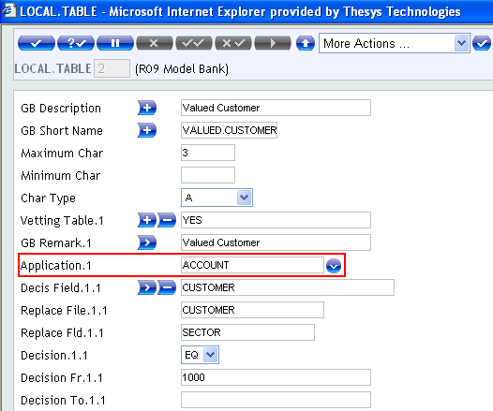
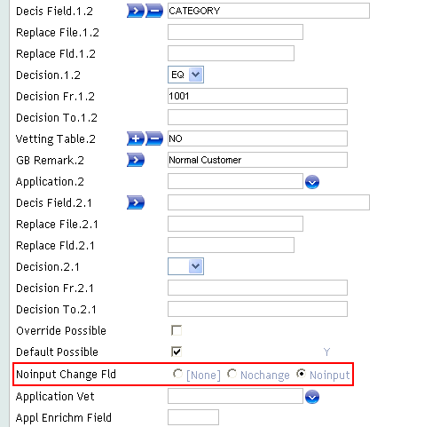
Solution

Slide 39
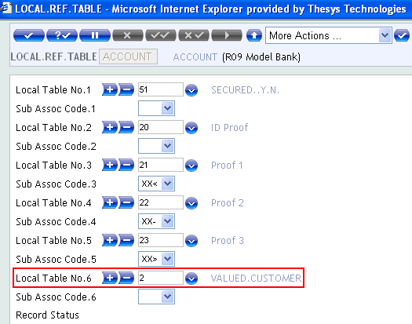
Solution
Attach the ID of local field in LOCAL.REF.FIELD

Slide 40
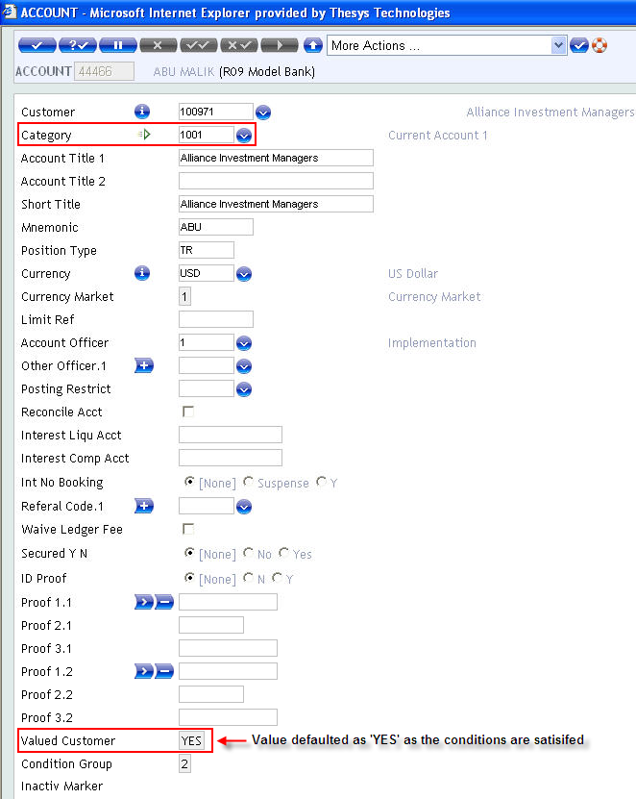
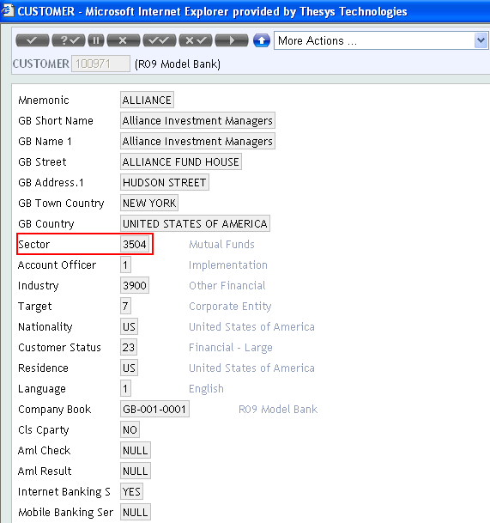
Solution
Check the conditional default of newly created local reference field, on committing the record

Slide 41
Summary
We have learnt how to
Create a local reference field for T24 application – LOCAL.TABLE & LOCAL.REF.TABLE applications
Create a conditional local reference field for T24 application – LOCAL.TABLE application

Slide 43


www.capgemini.com/financialservices

